Slide 1
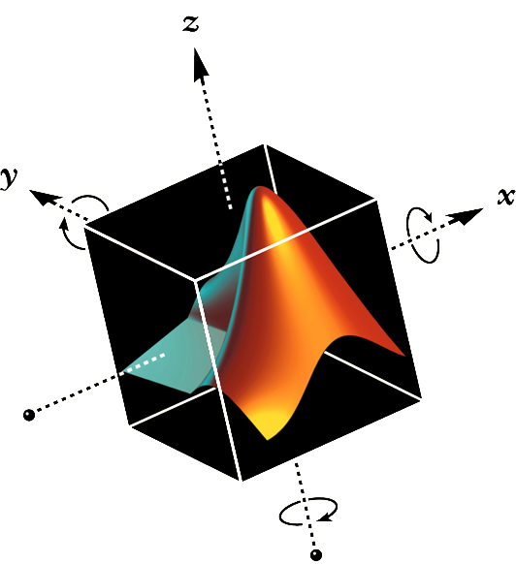

ECEN/MAE 3723 – Systems I
MATLAB Lecture 3

Slide 2
Lecture Overview
Building Models for LTI System
  Continuous Time Models
  Discrete Time Models
Combining Models
Transient Response Analysis
Frequency Response Analysis
Stability Analysis Based on Frequency Response
Other Information

Slide 3
Building Models for LTI System
Control System Toolbox supports continuous time models and discrete time models of the following types*:
  Transfer Function
  Zero-pole-gain
  State Space
* Material taken from http://techteach.no/publications/control_system_toolbox/#c1

Slide 4
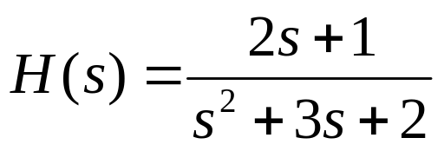
Continuous Time Transfer Function(1)
Function: Use tf function create transfer function of following form:
Example
Matlab Output
>>num = [2 1];
>>den = [1 3 2];
>>H=tf(num,den)
Transfer function:
2 s + 1
-------------
s^2 + 3 s + 2

Slide 5
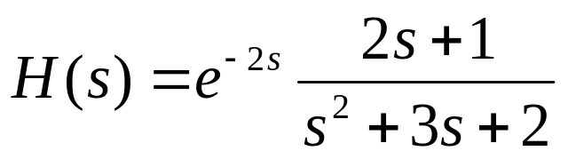
Continuous Time Transfer Function(2)
Include delay to continuous time Transfer Function
Example
>>num = [2 1];
>>den = [1 3 2];
>>H=tf(num,den,’inputdelay’,2)
Transfer function:
2 s + 1
exp(-2*s) * -------------
s^2 + 3 s + 2
Matlab Output

Slide 6
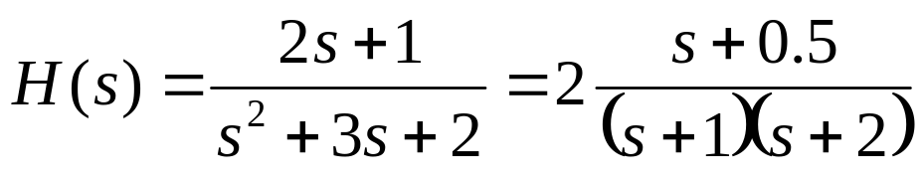
Continuous Time Transfer Function(3)
Function: Use zpk function to create transfer function of following form:
Example
Matlab Output
>>num = [-0.5];
>>den = [-1 -2];
>>k = 2;
>>H=zpk(num,den,k)
Zero/pole/gain:
2 (s+0.5)
-----------
(s+1) (s+2)

Slide 7
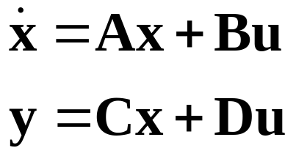
Continuous Time State Space Models(1)
State Space Model for dynamic system
Matrices: A is state matrix; B is input matrix; C is output matrix; and D is direct transmission matrix
Vectors: x is state vector; u is input vector; and y is output vector
Note: Only apply to system that is linear and time invariant

Slide 8
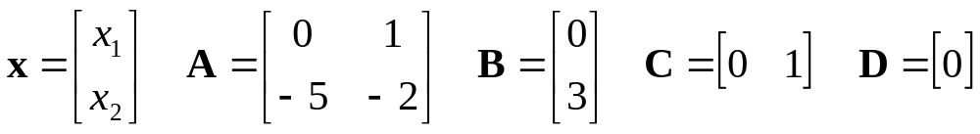
Continuous Time State Space Models(2)
Function: Use ss function creates state space models. For example:
Matlab Output
>>A = [0 1;-5 -2];
>>B = [0;3];
>>C = [0 1];
>>D = [0];
>>sys=ss(A,B,C,D)
a =
x1 x2
x1 0 1
x2 -5 -2
b =
u1
x1 0
x2 3
c =
x1 x2
y1 0 1
d =
u1
y1 0

Slide 9
Conversion between different models
Converting From | Converting to | Matlab function
Transfer Function | Zero-pole-gain | [z,p,k]=tf2zp(num,den)
Transfer Function | State Space | [A,B,C,D]=tf2ss(num,den)
Zero-pole-gain | Transfer Function | [num,den]=zp2tf(z,p,k)
Zero-pole-gain | State Space | [A,B,C,D]=zp2ss(z,p,k)
State Space | Transfer Function | [num,den]=ss2tf(A,B,C,D)
State Space | Zero-pole-gain | [z,p,k]=ss2zp(A,B,C,D)

Slide 10
Lecture Overview
Building Models for LTI System
  Continuous Time Models
  Discrete Time Models
Combining Models
Transient Response Analysis
Frequency Response Analysis
Stability Analysis Based on Frequency Response
Other Information

Slide 11
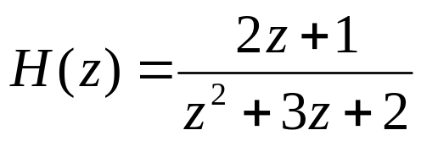
Discrete Time Transfer Function(1)
Function: Use tf function create transfer function of following form:
Example: with sampling time 0.4
Matlab Output
>>num = [2 1];
>>den = [1 3 2];
>>Ts=0.4;
>>H=tf(num,den,Ts)
Transfer function:
2 z + 1
-------------
z^2 + 3 z + 2
Sampling time: 0.4

Slide 12
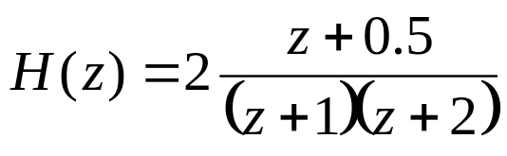
Discrete Time Transfer Function(2)
Function: Use zpk function to create transfer function of following form:
Example: with sampling time 0.4
Matlab Output
>>num = [-0.5];
>>den = [-1 -2];
>>k = 2;
>>Ts=0.4;
>>H=zpk(num,den,k,Ts)
Zero/pole/gain:
2 (z+0.5)
-----------
(z+1) (z+2)
Sampling time: 0.4

Slide 13
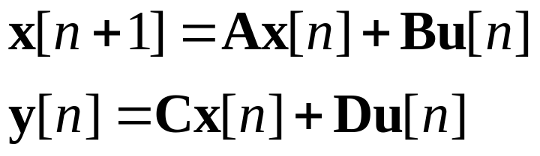
Discrete Time State Space Models(1)
State Space Model for dynamic system
Matrices: A is state matrix; B is input matrix; C is output matrix; and D is direct transmission matrix
Vectors: x is state vector; u is input vector; and y is output vector
n is the discrete-time or time-index
Note: Only apply to system that is linear and time invariant

Slide 14
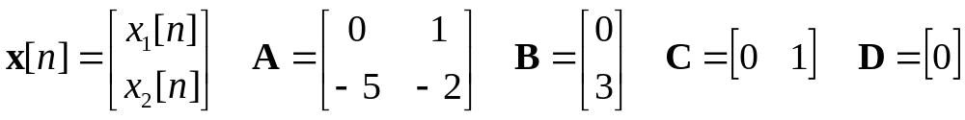
Discrete Time State Space Models(2)
Function: Use ss function creates state space models. For example:
Matlab Output
Matlab Output
>>A = [0 1;-5 -2];
>>B = [0;3];
>>C = [0 1];
>>D = [0];
>>Ts= [0.4];
>>sys=ss(A,B,C,D,Ts)
a =
x1 x2
x1 0 1
x2 -5 -2
b =
u1
x1 0
x2 3
Transfer function:
2 z + 1
-------------
z^2 + 3 z + 2
Sampling time: 0.4
c =
x1 x2
y1 0 1
d =
u1
y1 0
Sampling time: 0.4

Slide 15
Lecture Overview
Building Models for LTI System
  Continuous Time Models
  Discrete Time Models
Combining Models
Transient Response Analysis
Frequency Response Analysis
Stability Analysis Based on Frequency Response
Other Information

Slide 16
Combining Models(1)
A model can be thought of as a block with inputs and outputs (block diagram) and containing a transfer function or a state-space model inside it
A symbol for the mathematical operations on the input signal to the block that produces the output
Transfer
Function
G(s)
Input
Output
Elements of a Block Diagram

Slide 17
Combining Models(2)
The Following Matlab functions can be used to perform basic block diagram manipulation
Combination | Matlab Command
 | sys = series(G1,G2)
 | sys = parallel(G1,G2)
 | sys = feedback(G1,G2)
G₁(s)
G₂(s)
+
G₁(s)
+
G₂(s)
+
G₁(s)
-
G₂(s)

Slide 18
Basic arithmetic operations of Models
Arithmetic Operations | Matlab Code
Addition | sys = G1+G2;
Multiplication | sys = G1*G2;
Inversion | sys = inv(G1);

Slide 19
Lecture Overview
Building Models for LTI System
  Continuous Time Models
  Discrete Time Models
Combining Models
Transient Response Analysis
Frequency Response Analysis
Stability Analysis Based on Frequency Response
Other Information

Slide 20
Transient Response Analysis(1)
Transient response refers to the process generated in going from the initial state to the final state
Transient responses are used to investigate the time domain characteristics of dynamic systems
Common responses: step response, impulse response, and ramp response

Slide 21
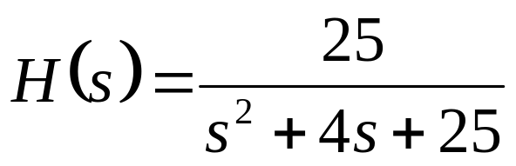
Transient Response Analysis(2)
Unit step response of the transfer function system
Consider the system:
%*****Numerator & Denominator of H(s)
>>num = [0 0 25];den = [1 4 25];
%*****Specify the computing time
>>t=0:0.1:7;
>>step(num,den,t)
%*****Add grid & title of plot
>>grid
>>title(‘Unit Step Response of H(s)’)

Slide 22
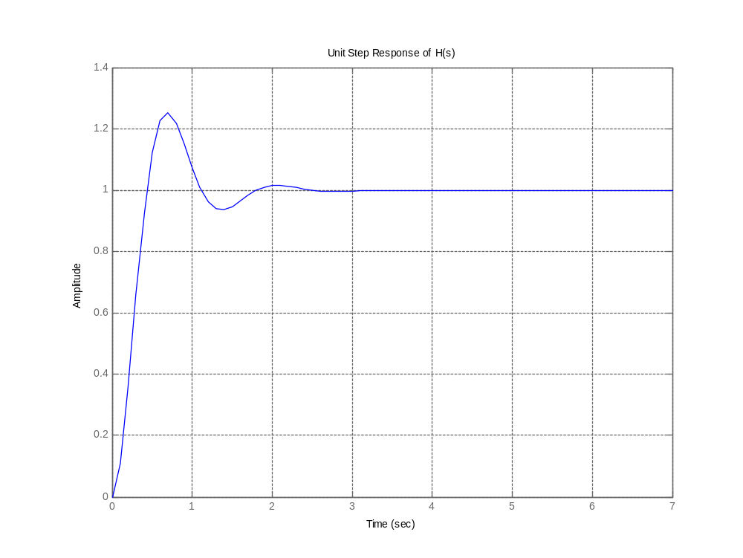
Transient Response Analysis(3)
Unit step response of H(s)

Slide 23
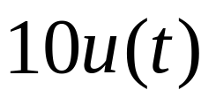
Transient Response Analysis(4)
Alternative way to generate Unit step response of the transfer function, H(s)
If step input is , then step response is generated with the following command:
%*****Numerator & Denominator of H(s)
>>num = [0 0 25];den = [1 4 25];
%*****Create Model
>>H=tf(num,den);
>>step(H)
>>step(10*H)

Slide 24
Transient Response Analysis(5)
Impulse response of the transfer function system
Consider the system:
%*****Numerator & Denominator of H(s)
>>num = [0 0 25];den = [1 4 25];
%*****Specify the computing time
>>t=0:0.1:7;
>>impulse(num,den,t)
%*****Add grid & title of plot
>>grid
>>title(‘Impulse Response of H(s)’)

Slide 25
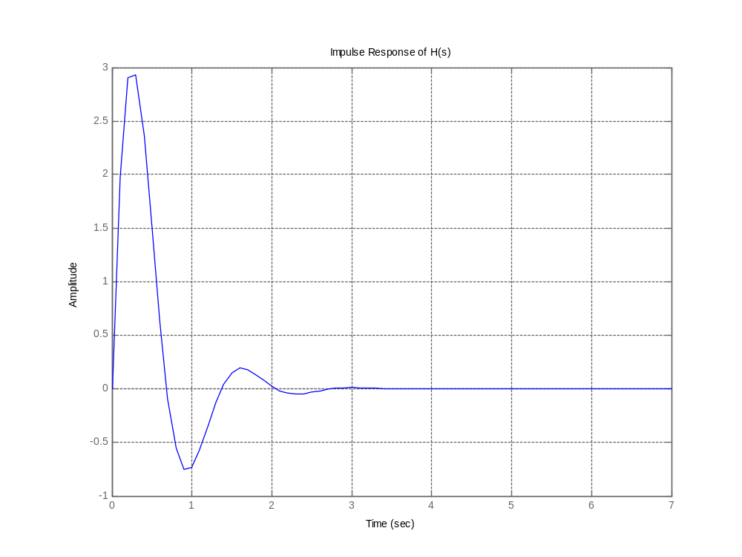
Transient Response Analysis(6)
Impulse response of H(s)

Slide 26
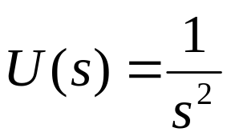
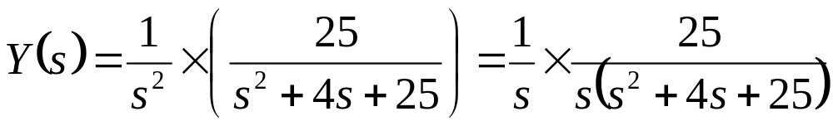
Transient Response Analysis(7)
Ramp response of the transfer function system
There’s no ramp function in Matlab
To obtain ramp response of H(s), divide H(s) by “s” and use step function
Consider the system:
For unit-ramp input, . Hence
NEW H(s)
Indicate Step response

Slide 27
Transient Response Analysis(8)
Example: Matlab code for Unit Ramp Response
%*****Numerator & Denominator of NEW H(s)
>>num = [0 0 0 25];den = [1 4 25 0];
%*****Specify the computing time
>>t=0:0.1:7;
>>y=step(num,den,t);
%*****Plot input & the ramp response curve
>>plot(t,y,’.’,t,t,’b-’)
%*****Add grid & title of plot
>>grid
>>title(‘Unit Ramp Response Curve of H(s)’)

Slide 28
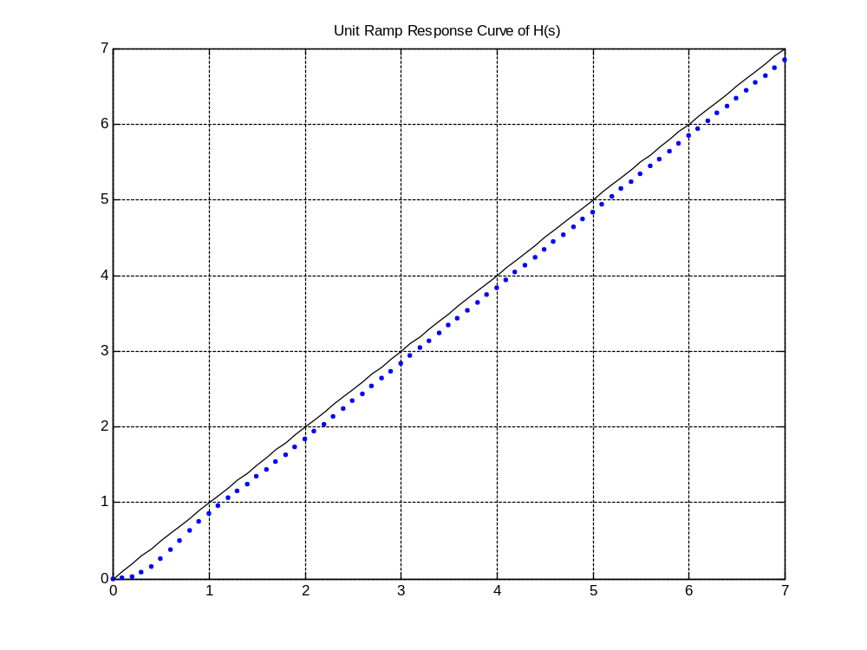
Transient Response Analysis(9)
Unit Ramp response of H(s)

Slide 29
Lecture Overview
Building Models for LTI System
  Continuous Time Models
  Discrete Time Models
Combining Models
Transient Response Analysis
Frequency Response Analysis
Stability Analysis Based on Frequency Response
Other Information

Slide 30
Frequency Response Analysis(1)
For Transient response analysis - hard to determine accurate model (due to noise or limited input signal size)
Alternative: Use frequency response approach to characterize how the system behaves in the frequency domain
Can adjust the frequency response characteristic of the system by tuning relevant parameters (design criteria) to obtain acceptable transient response characteristics of the system

Slide 31
Frequency Response Analysis(2)
Bode Diagram Representation of Frequency Response
Consists of two graphs:
  Log-magnitude plot of the transfer function
  Phase-angle plot (degree) of the transfer function
Matlab function is known as ‘bode’
%*****Numerator & Denominator of H(s)
>>num = [0 0 25];den = [1 4 25];
%*****Use ‘bode’ function
>>bode(num,den)
%*****Add title of plot
>>title(‘Bode plot of H(s)’)

Slide 32
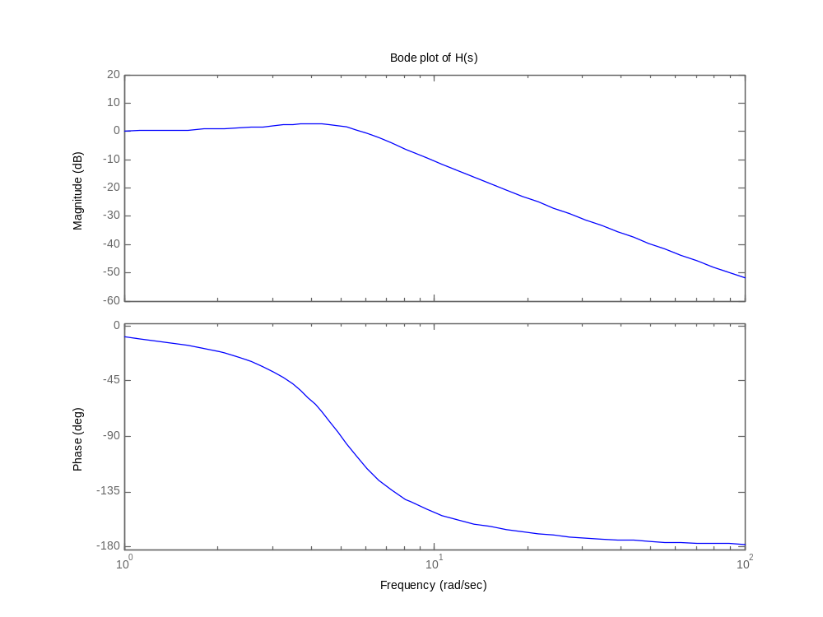
Frequency Response Analysis(3)
Example: Bode Diagram for
Bode magnitude plot
Bode phase plot

Slide 33
Lecture Overview
Building Models for LTI System
  Continuous Time Models
  Discrete Time Models
Combining Models
Transient Response Analysis
Frequency Response Analysis
Stability Analysis Based on Frequency Response
Other Information

Slide 34
Stability Analysis Based on Frequency Response(1)
Stability analysis can also be performed using a Nyquist plot
From Nyquist plot – determine if system is stable and also the degree of stability of a system
Using the information to determine how stability may be improved
Stability is determined based on the Nyquist Stability Criterion

Slide 35
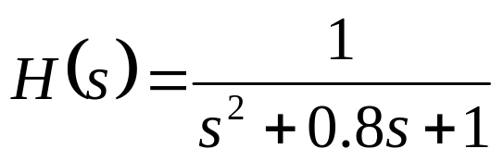
Stability Analysis Based on Frequency Response(2)
Example: Matlab code to draw a Nyquist Plot
Consider the system
%*****Numerator & Denominator of H(s)
>>num = [0 0 1];
>>den = [1 0.8 1];
%*****Draw Nyquist Plot
>>nyquist(num,den)
%*****Add grid & title of plot
>>grid
>>title(‘Nyquist Plot of H(s)’)

Slide 36
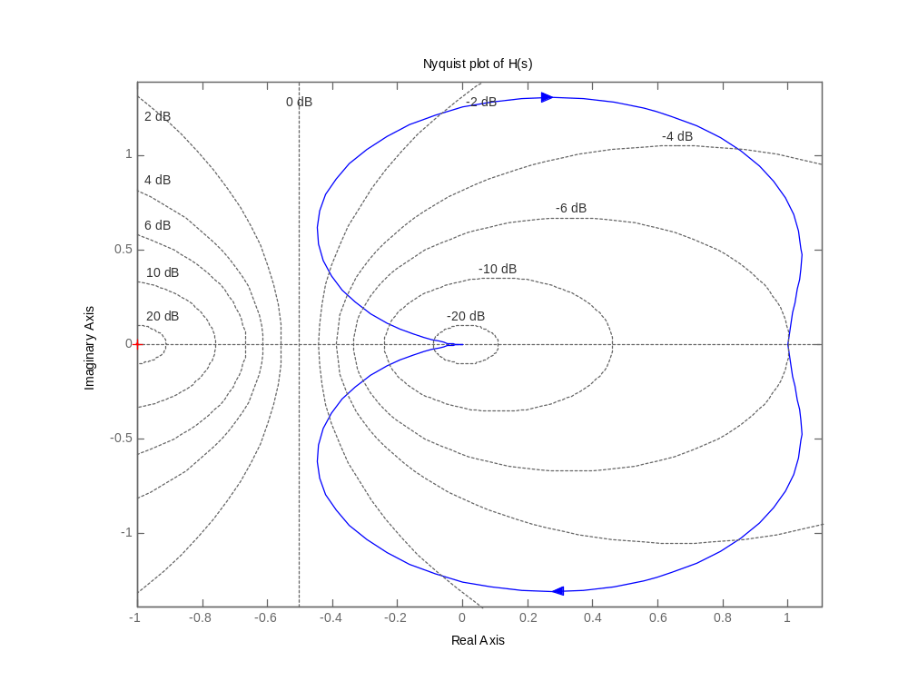
Stability Analysis Based on Frequency Response(2)
The Nyquist Plot for

Slide 37
Lecture Overview
Building Models for LTI System
  Continuous Time Models
  Discrete Time Models
Combining Models
Transient Response Analysis
Frequency Response Analysis
Stability Analysis Based on Frequency Response
Other Information

Slide 38
Other Information
Use help to find out more about the Matlab functions shown in this lecture
Check out Control System Toolbox for other Matlab functions

Slide 39
Procedure of Designing a Control System
System & Required Design Specifications
Mathematical Model
Test the System
Fulfill the Required Design Specification ?
  Transient Response Analysis
  Frequency Response Analysis
How stable or robust ? Is your system stable?
  Stability Analysis Based on Frequency Response
NO
Are (1) & (2) satisfy?
Revisit the design
e.g. Combine model?
YES
end

Slide 40
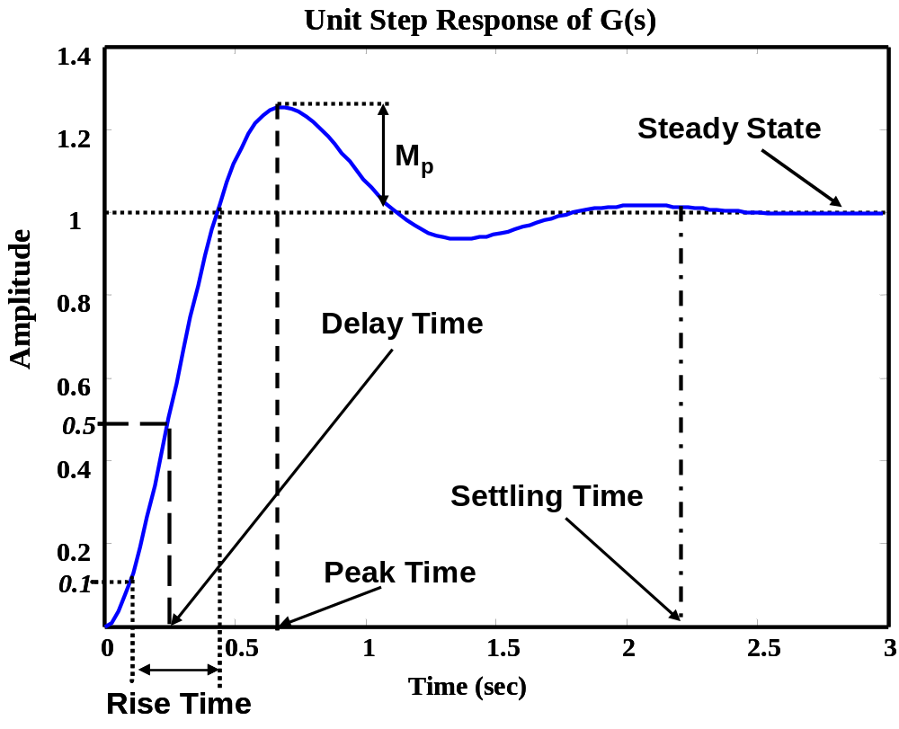
Transient response Specifications

Slide 41
Frequency Domain Characteristics
What is the bandwidth of the system?
What is the cutoff frequencies?
What is the cutoff rate?
Is the system sensitive to disturbance?
How the system behave in frequency domain?

